Slide 1
N, P, K Nutrient Deficiency Detection in Rice Plants
216066070
B.A. Prajapati
Biometrics Research Project

Slide 2
Introduction
Health monitoring of rice plants is an essential factor in rice farm management to maximize yields. Farmers need to maintain and track plant nutritional requirements because a nutrient deficit will seriously harm plants and their ability to produce quality-yield.
A rapid, accurate, and easy-to-use approach to the identification of nitrogen (N), phosphorus (P), and potassium (K) is beneficial to rice farmers. Rice plants exhibit distinct signs of lack of macronutrients N, P, K in the soil of the crop
This system aims to classify N, P, K nutrient deficiency in rice plants.

Slide 3
Problem Background
Rice agriculture is an essential agricultural field for several major rice-producing countries, such as Bangladesh, India, China, and Indonesia, moreover, rice agriculture contributes to these county's GDP.
Rice farmers do not have a comprehensive understanding of their rice crops, which can lead to a reduction in the quality of rice production and possibly incur a loss for farmers.

Slide 4
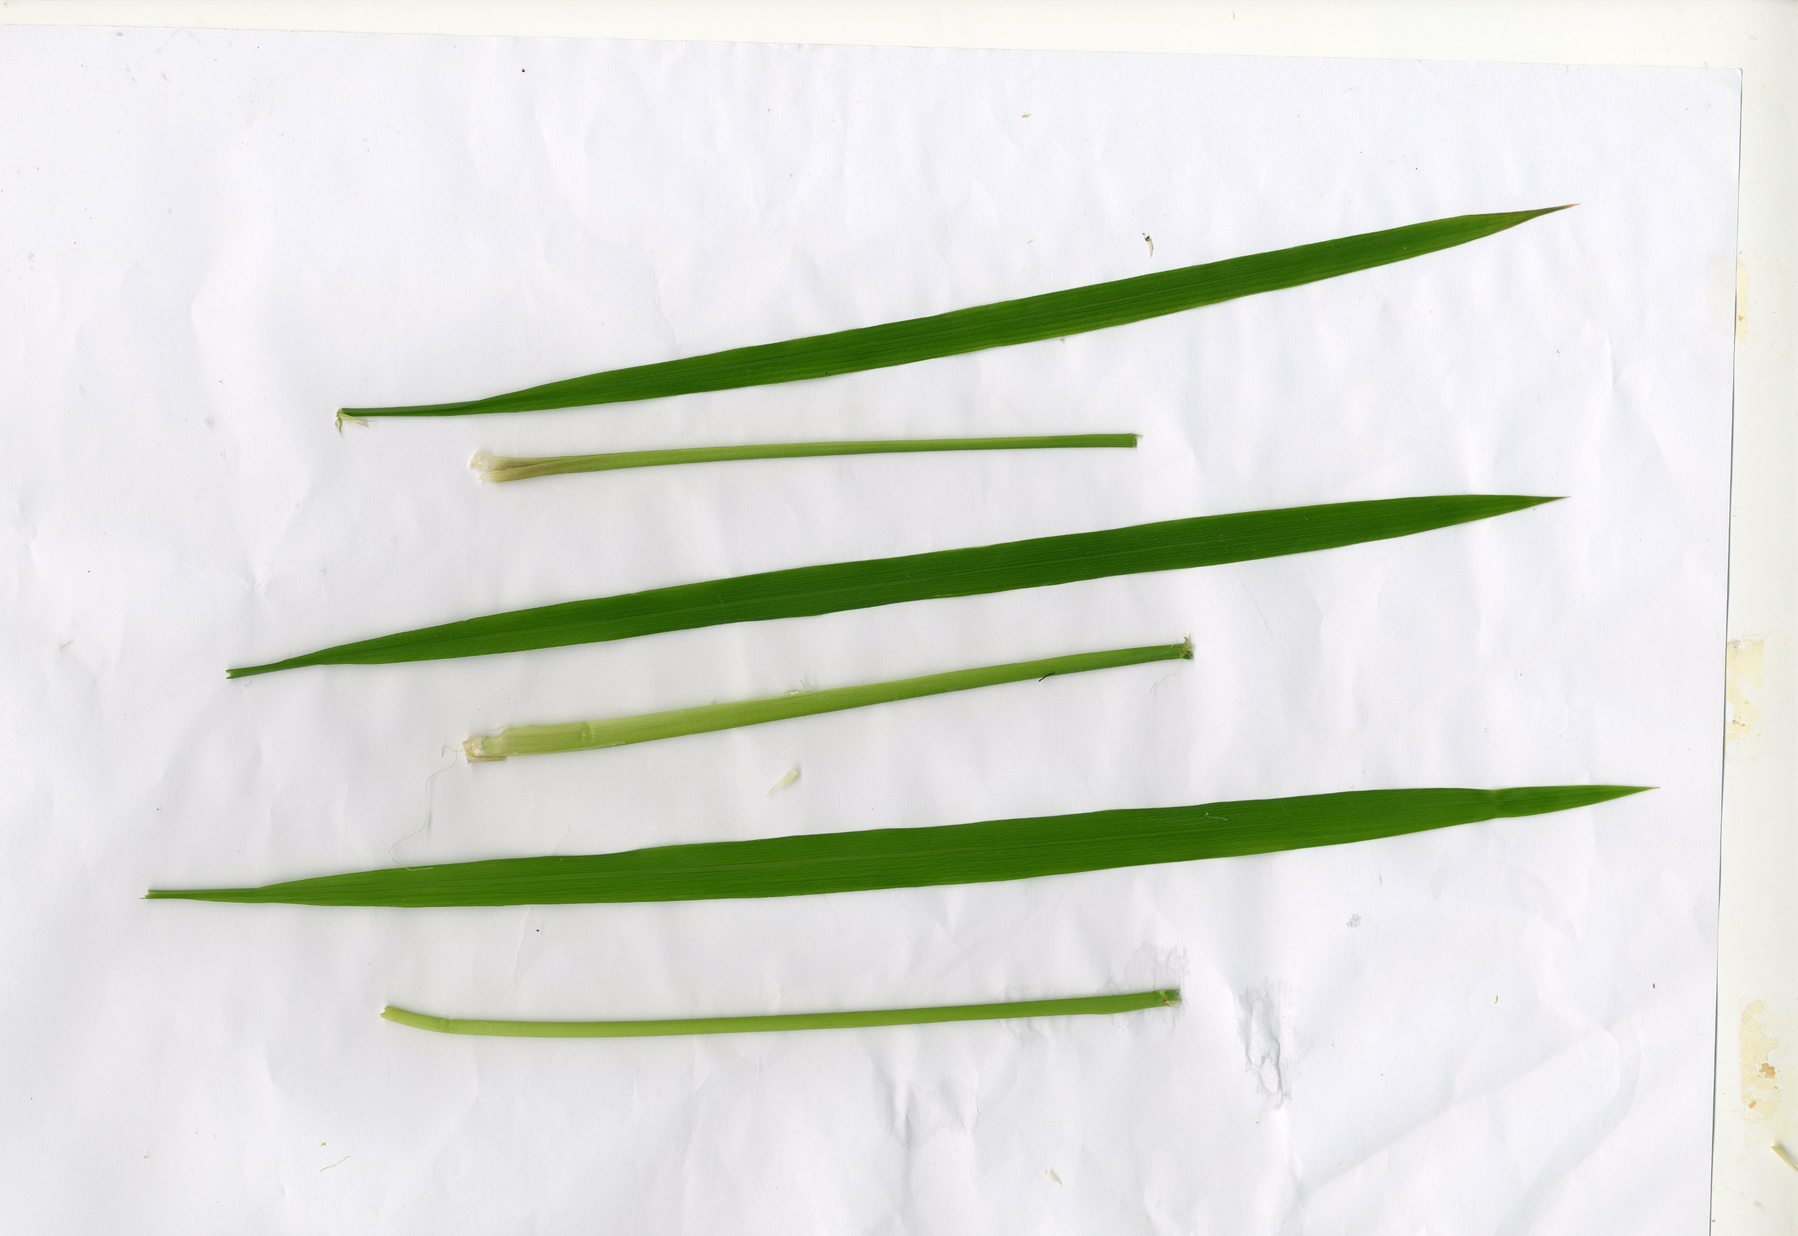
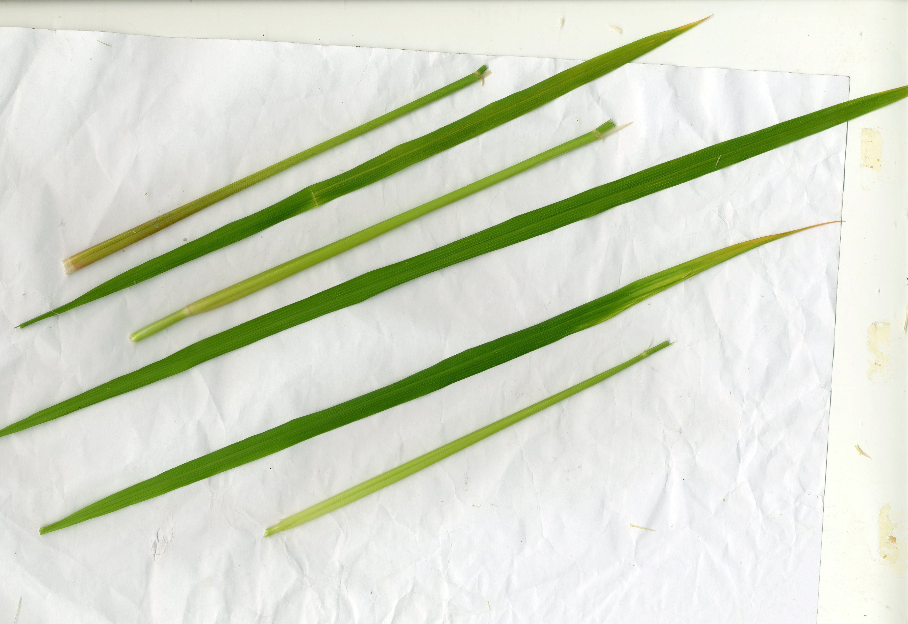

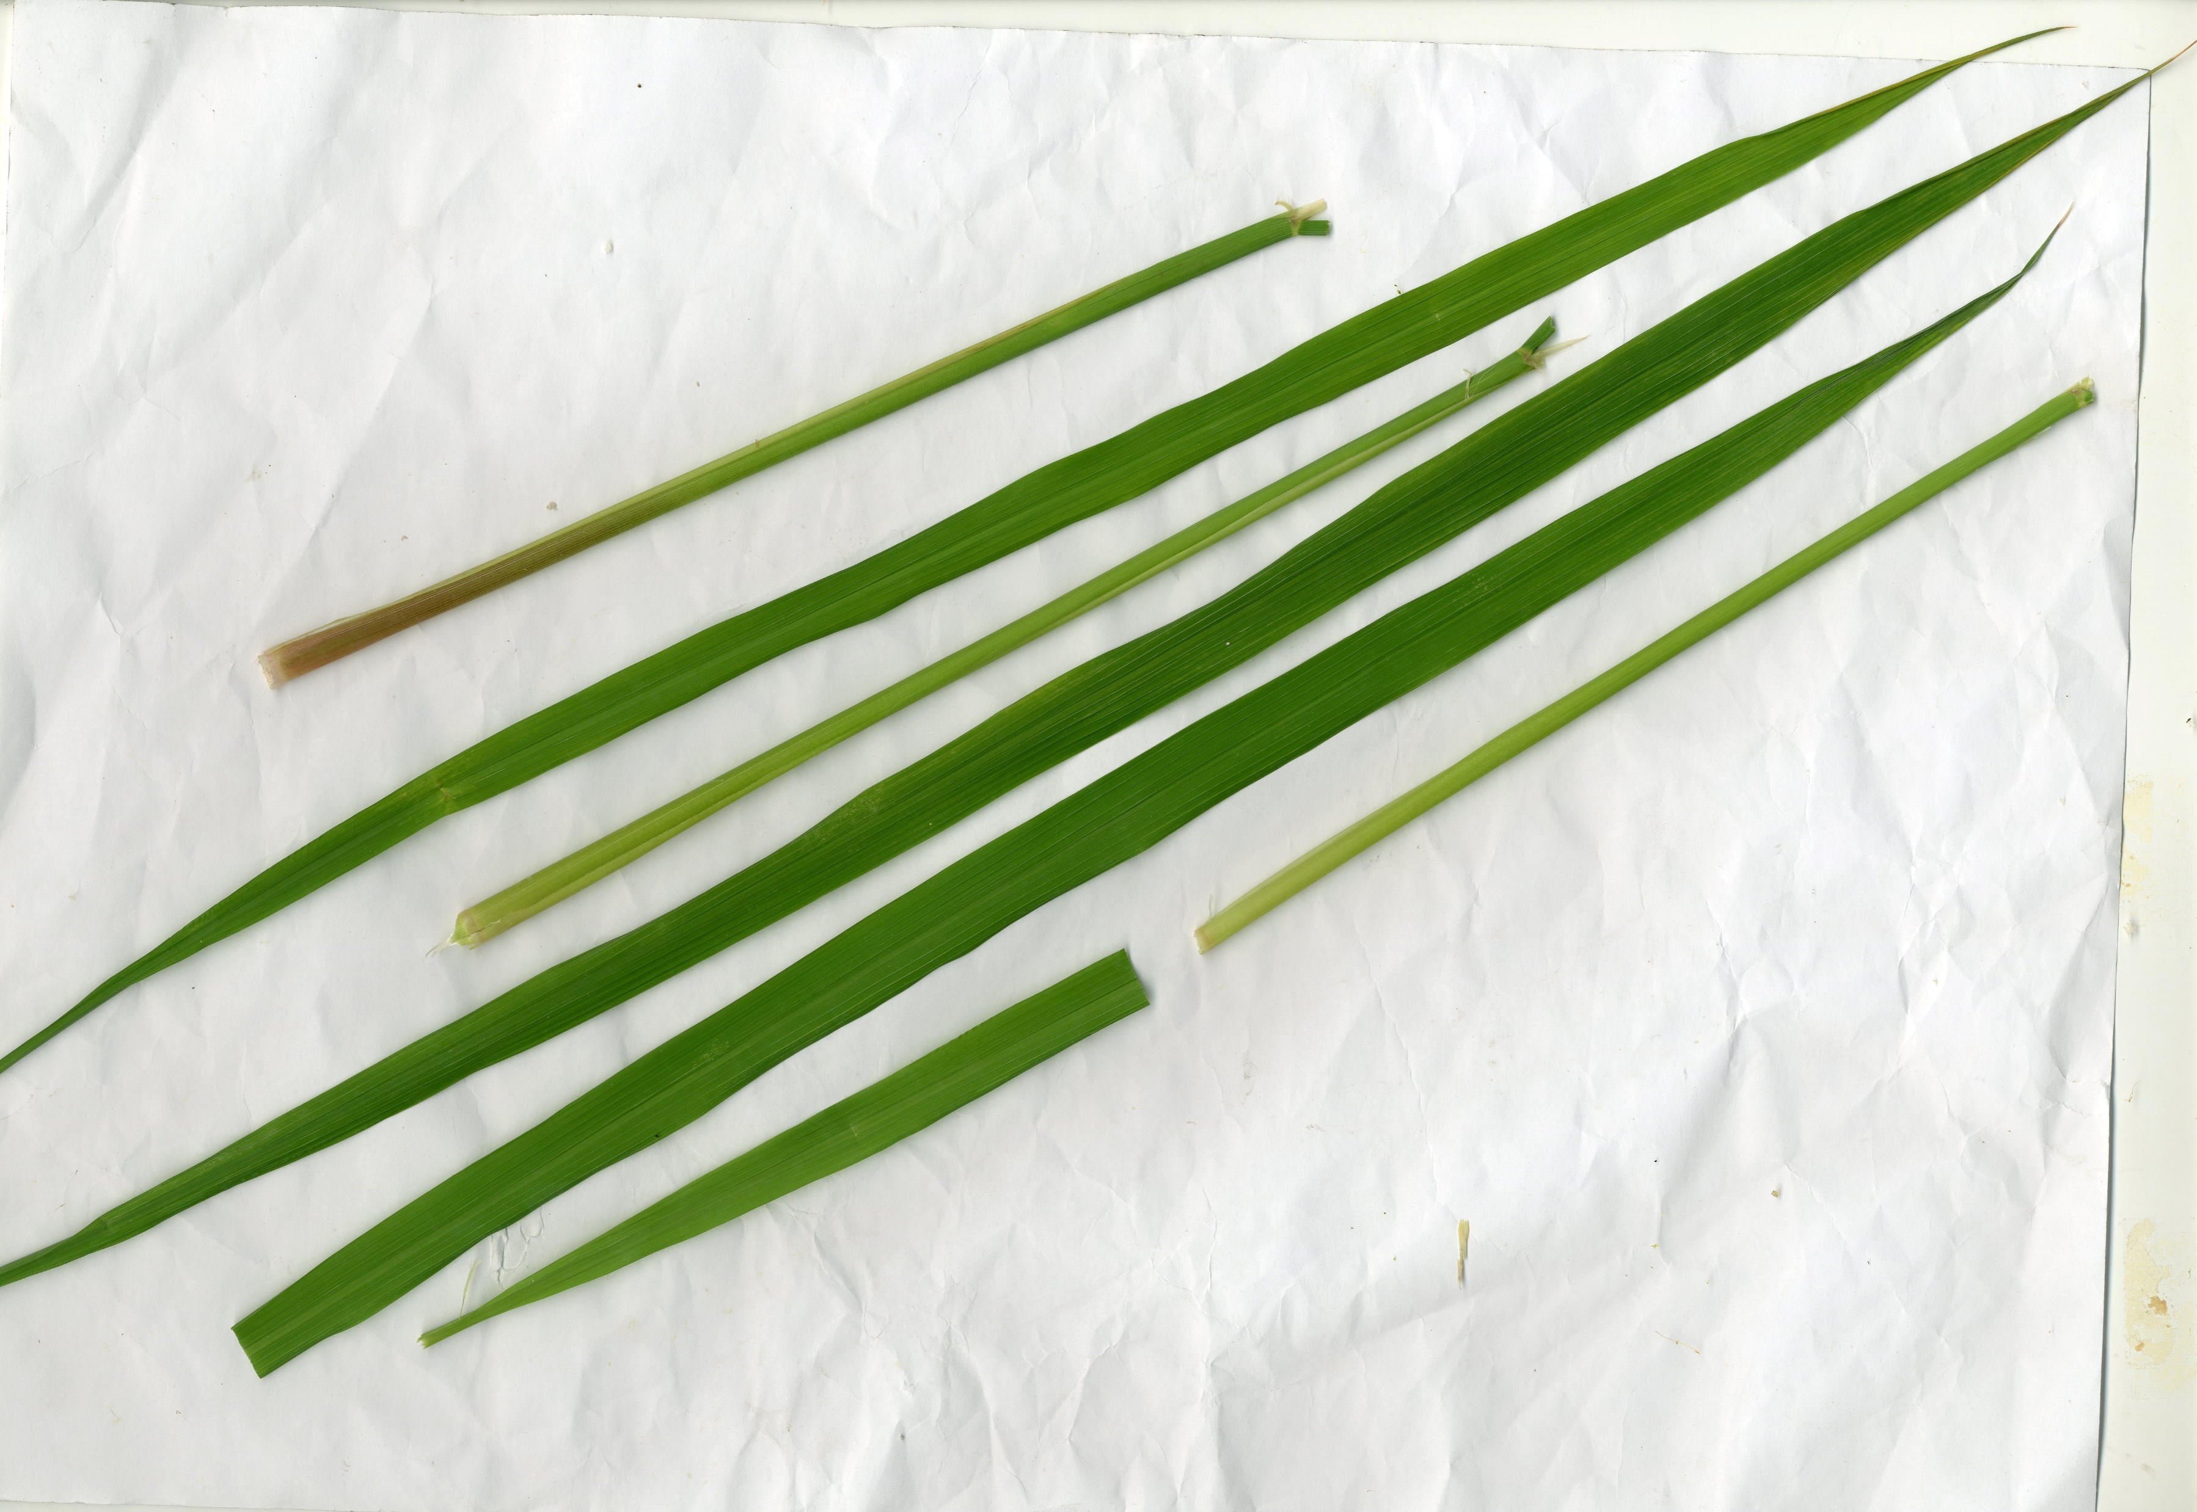
Training Dataset Samples

Slide 5


Pre-Processing
Leaf
Sheath

Slide 6
Features Extracted for Leaf and Sheath
Leaf: mean RGB values, Leaf tip RGB values, Leaf area, leaf length, leaf area to leaf length ratio, Leaf area and perimeter ration, Leaf lightness, normalized RGB index.
Sheath: RGB mean values, leaf sheath length.

Slide 7
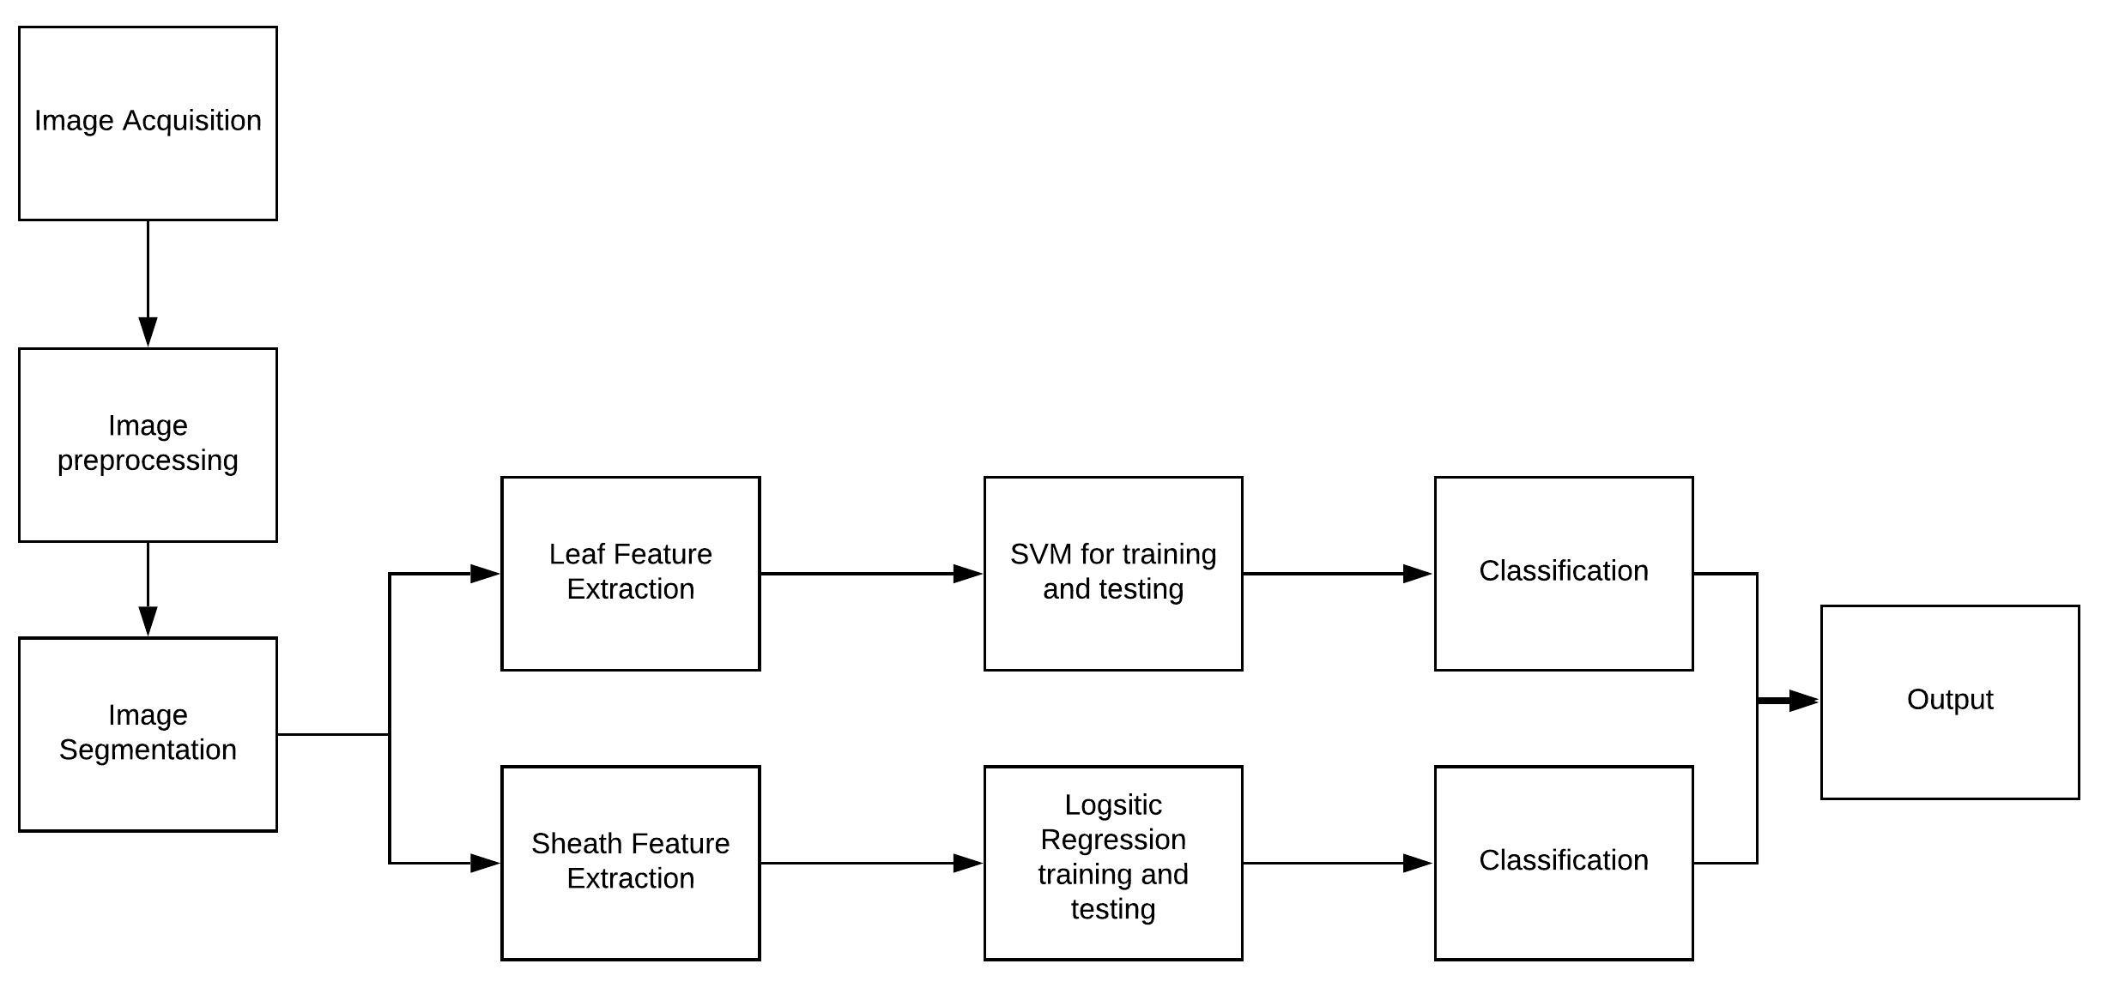
System Pipeline

Slide 8
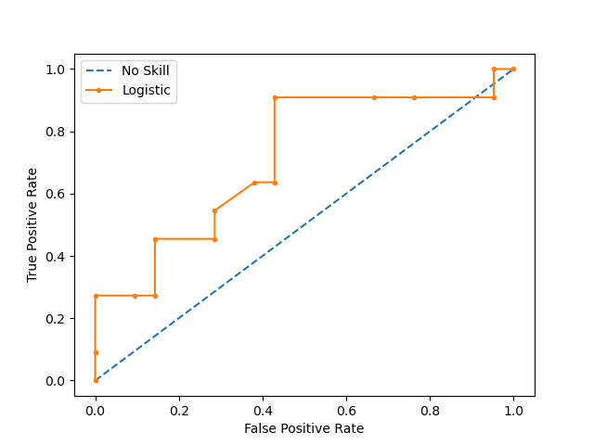
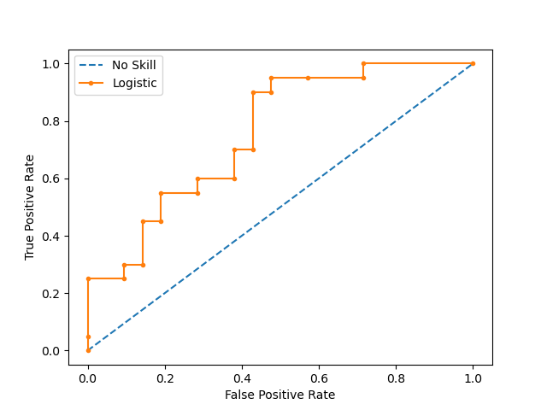
Results (Normal and Not Normal)
Sheath
Leaf
Accuracy: 0.625
Accuracy: 0.7073

Slide 9
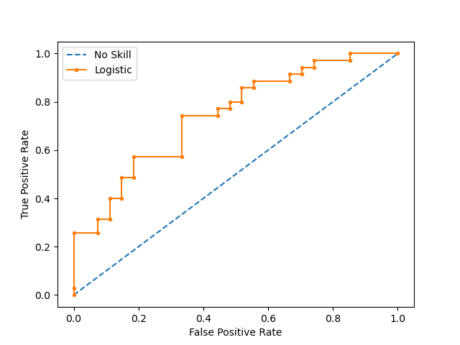
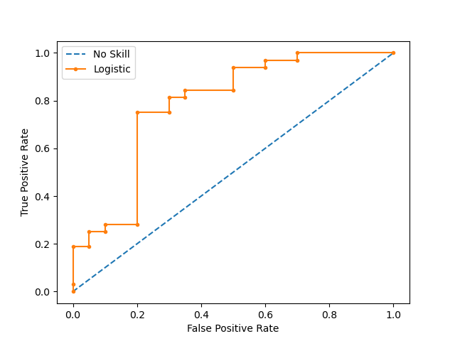
Results (N and PK)
Leaf
Sheath
Accuracy: 0.75
Accuracy: 0.661

Slide 10
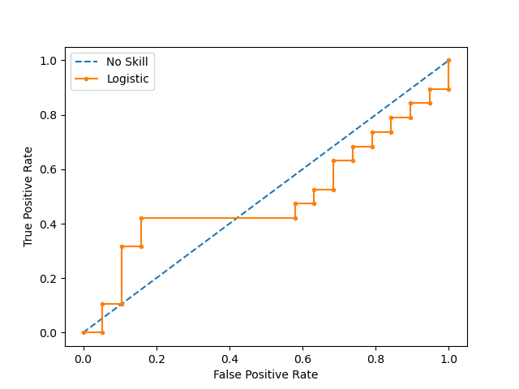
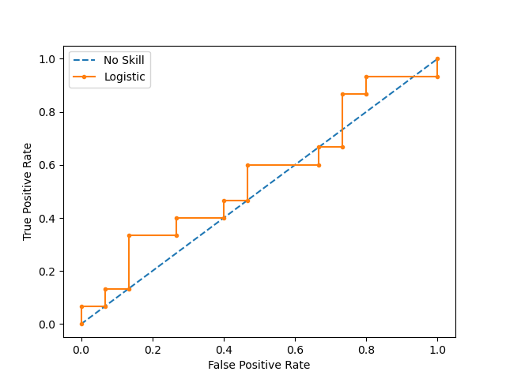
Results (P and K)
Sheath
Leaf
Accuracy: 0.4333
Accuracy: 0.4736

Slide 11
Conclusion
This system will help rice farmers to identify N, P, K nutrient deficiencies in rice so that they can provide the necessary nutrients required for the plant to be healthy.

